Slide 1
CSE 217 –
Compiler Design

Slide 2
Introduction

Slide 3
Instructors
Instructor-in-charge : Dr. Islabudeen. M
Instructors : Mr. Sukruth Gowda M.A,
Mr. Prasad P.S,
Mr. Rahul Biswas,
Ms. Shivali Shukya
Mr. Shine V.J

Slide 4
Evaluation Components
 | Duration (minutes) | % Weightage | Marks | Date & Time
Test 1 | 60 min | 20 | 40 | To be announced by COE
Test 2 | 60 min | 20 | 40 | To be announced by COE
Quiz / Class Test | 60 min | 20 | 40 | To be announced by Later
Comprehensive exam | 180 min | 40 | 100 | To be announced by COE

Slide 5
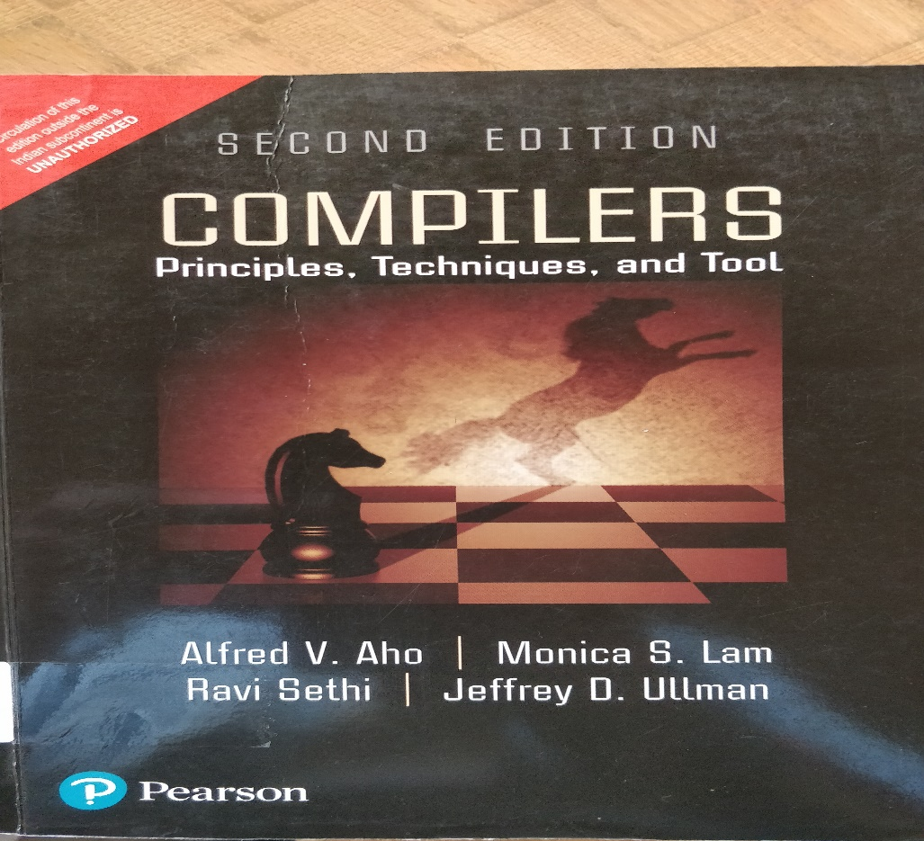
Slides are Mostly From
Text Books:
1. Alfred V. Aho, Jeffrey D Ullman, “Compilers: Principles, Techniques and Tools”, Pearson second Edition, 2013.
Reference Books:
Jean Paul Tremblay, Paul G Serenson, "The Theory and Practice of Compiler Writing", BS Publications, 2005.
C. N. Fischer and R. J. LeBlanc, “Crafting a compiler with C”, Benjamin Cummings, 2003.
HenkAlblas and Albert Nymeyer, “Practice and Principles of Compiler Building with C”, PHI, 2001.
Kenneth C. Louden, “Compiler Construction: Principles and Practice”, Thompson Learning, 2003.
Dhamdhere, D. M., "Compiler Construction Principles and Practice", Macmillan India Ltd, 2008

Slide 6
Course Content (Syllabus):
Module I: INTRODUCTION AND LEXICAL ANALYSIS (13 hours) [COMPREHENSION]
Compilers – Cousins of the Compiler - Phases of a compiler - Analysis of the source program - Grouping of phases – Compiler construction tools – Lexical Analysis – Role of the Lexical Analyzer – Input buffering – Specification of tokens – Recognizer - Introduction to LEX Programming.
Module II: SYNTAX ANALYSIS (15 hours) [APPLICATION]
Role of the parser - Top-down parsing - Recursive decent parser - Predictive parser - Bottom-up parsing – Shift reduce parser - LR parser – SLR parser – Canonical parser – LALR parser - YACC programming.
Module III: SEMANTIC ANALYSIS AND INTERMEDIATE CODE GENERATION (14 hours) [APPLICATION]
Introduction to syntax directed translation - Synthesis and inherited attributes - Type Checking - Type Conversions - Intermediate languages – Three address statements - Declarations – Assignment Statements – Boolean Expressions – Case Statements – Back patching – Looping statements - Procedure calls.
Module IV: CODE OPTIMIZATION AND CODE GENERATION (12 hours) [COMPREHENSION]
Basic Blocks and Flow Graphs – Principal sources of optimization – Peephole optimization - Optimization of basic Blocks - DAG representation of Basic Blocks - Issues in the design of code generator – A simple code generator.

Slide 7
Course Outcomes:
On successful completion of the course the students shall be able to:
CO1: Explain the various phases of compiler (COMPREHENSION)
CO2: Apply parsing techniques to check the syntax of given statement. (APPLICATION)
CO3: Produce intermediate code for the given statement. (APPLICATION)
CO4: Discuss how to optimize the given problem for back end of the compiler (COMPREHENSION)

Slide 8
Program Outcomes
PO1 Engineering Knowledge:
Apply the knowledge of mathematics, science, engineering fundamentals, and an engineering specialization to the solution of complex engineering problems. [High]
PO2 Problem Analysis:
Identify, formulate, research literature, and analyze complex engineering problems reaching substantiated conclusions using first principles of mathematics, natural sciences, and engineering sciences. [High]
PO3 Design/development of Solutions:
Design solutions for complex engineering problems and design system components or processes that meet the specified needs with appropriate consideration for the public health and safety, and the cultural, societal, and environmental considerations. (High]
PO4 Conduct Investigations of Complex Problems:
Use research-based knowledge and research methods including design of experiments, analysis and interpretation of data, and synthesis of the information to provide valid conclusions.[High]
PO5 Modern Tool usage:
Create, select, and apply appropriate techniques, resources, and modern engineering and IT tools including prediction and modelling to complex engineering activities with an understanding of the limitations. [Moderate]
PO10 Communication:
Communicate effectively on complex engineering activities with the engineering community and with society at large, such as, being able to comprehend and write effective reports and design documentation, make effective presentations, and give and receive clear instructions. [Low]

Slide 9
Mapping of CO with PO
CO / PO N0. | PO1 | PO2 | PO3 | PO4 | PO5 | PO10
CO1 | H | M | M | M | M | L
CO2 | H | H | H | H | M | L
CO3 | H | H | H | H | - | L
CO4 | H | H | M | M | - | L

Slide 10
Course Prerequisites
Finite Automata, Context Free Grammar
(CSE208 - Theory of Computation – CSE 5th Semester Course)
System software

Slide 11
#include<stdio.h>
#define N 10
main()
{
int a;
a = N + 20;
printf(“%d”,a);
}
Monitor
30

Slide 12
Editor
#include<stdio.h>
#define N 10
main()
{
int a;
a = N + 20;
printf(“%d”,a);
}
Pre-processor
Compiler
Assembler
Interpreter
Linker & Loader
RAM
Operating System
CPU
Monitor
30

Slide 13
COMPILER
Compiler is a program that reads a program written in one language (source language) and translates it into an equivalent program in another language (the target language).
As an important part of this translation process, the compiler reports to its user the presence of errors in the source program.
Source Program
Compiler
Target Program
Error Messages

Slide 14
Source code
written in a high level programming language
//simple example
while (sum < total)
{
sum = sum + x*10;
}
Target code
Assembly language which in turn is translated to machine code
L1: MOV total,R0
CMP sum,R0
CJ< L2
GOTO L3
L2: MOV #10,R0
MUL x,R0
ADD sum,R0
MOV R0,sum
GOTO L1
L3: First Instruction following
the while statement

Slide 15
Why build compilers?
Programming languages are notations for describing computations to people and to machines. The world as we know it depends on programming languages, because all the software running on all the computers was written in some programming language. But, before a program can be run, it first must be translated into a form in which it can be executed by a computer.
Compilers provide an essential interface between applications and architectures
Compilers efficiently bridge the gap and shield the application developers from low level machine details

Slide 16
Why study compilers?
Compilers embody a wide range of theoretical techniques and their application to practice
DFAs, PDAs, formal languages, formal grammars, fix points algorithms, lattice theory, etc…
Compiler construction teaches programming and software engineering skills
Compiler construction involves a variety of areas
theory, algorithms, systems, architecture
Is compiler construction a solved problem?
No! New developments in programming languages and machine architectures (processors) present new challenges

Slide 17
Desirable Properties of Compilers
Compiler must generate a correct executable
The input program and the output program must be equivalent, the compiler should preserve the meaning of the input program
Output program should run fast
For optimizing compilers we expect the output program to be more efficient than the input program
Compiler should provide good diagnostics for programming errors
Compiler should work well with debuggers
Compile time should be proportional to code size

